Slide 1
Wardrobe Detection and Virtual Try Out using AI and Cognition
CSE4059 J-Component

Slide 2
CONTENTS
01
02
03
04
06
07
Abstract
Introduction
AI for Fashion in Modern Era
Models Used
Demonstration
Conclusion

Slide 3
OUR TEAM
Moin Ahmed Zahir
20BAI1120
Siddharth Shankar Das
20BAI1125
Daksh Bagga
20BAI1157

Slide 4
Challenges identified
There are several challenges that can arise while coding and working with a fashion detection model.
One of the challenges is the quality of labels in the dataset used for training the model. For example, an image may show two items: a blouse and shorts, but it may only have a “blouse” label. This way the model will inevitably suffer from noise.
Another challenge is to accurately detect, recognize, and recommend or generate new designs using an AI-powered deep learning system in the fashion industry. Additionally, testing the capabilities of the selected model can be challenging as it involves replication of the authors’ results on the original data and custom preprocessing models.

Slide 5
Problem Statement
In the fashion industry, there is a growing demand for virtual try-on experiences that allow customers to see how clothes and accessories would look on them before making a purchase. However, traditional virtual try-on systems often rely on static data and fail to account for the dynamic nature of fashion trends and individual preferences. This can result in inaccurate and unappealing virtual try-on experiences that do not meet the needs of customers.
To address this challenge, there is a need for an AI-powered fashion try-on system that can incorporate dynamic data to provide more accurate and personalized virtual try-on experiences. This system should be able to analyze real-time data on fashion trends and individual preferences to generate virtual try-on experiences that are tailored to the needs of each customer. By leveraging the power of AI and dynamic data, this system has the potential to revolutionize the way customers shop for clothes and accessories.

Slide 6
Individual Contribution
Siddharth Shankar Das (20BAI1125) – Handled the algorithmic solution for the given problem, tried various models, worked with esteemed researchers and signed exclusive data rights.
Moin Ahmed Zahir (20BAI1120) – Worked together to come up with precise algorithmic solution for the given problem, contributed to the dataset, contributed towards documentation part as well.
Daksh Bagga (20BAI1157) – Collecting data, analyzing data, fine tuning models, working towards finding a logical solution to the given problem statement and documenting it along the way

Slide 7
Abstract
Nowadays, the fashion business is shifting toward fast fashion, providing a wide range of clothing products in a quicker and more affordable way.
To do this, fashion designers must create a large and varied selection of fashion products in a short length of time.
For this scenario, Our project has fantastic potential for the fashion sector which can be created by the quick development of computer vision, artificial intelligence and Cognitive systems in addition to the current expanding need for online shopping platforms.
As a result, we are also planning to add the Virtual Try-out after detecting the Wardrobe.

Slide 8
Introduction
Every day, the fashion industry faces new obstacles because it is driven by constant development and advancement. With an estimated worth of up to 3,000 billion US dollars, the fashion business is currently one of the largest economies in the world. One of the oldest human endeavors, the production of clothing, has evolved over time as a result of constant technological and social advancements. The fashion industry is quickly embracing the post-modern, Industry 4.0, and most recently, Industry 5.0 garment production technologies, together with all the most recent digital advancements, in an effort to stay up with the swiftly changing consumer needs. Unquestionably, the world today is interested in the holistic realization of economic, social, and cultural sustainability. The elimination of various well-known damaging industries' polluting activities and production processes, including the fashion industry, is the focus of all current efforts. Over the past several years, there has been a noticeable growth in the number of initiatives and actions done to lessen the environmental activities of the fashion sector. The players engaged still don't seem to be pushing the wagon in one way, despite the apparent results.

Slide 9
AI for Fashion In Modren Era
A number of techniques used in artificial intelligence are particularly effective in the fashion industry. The "3V" of big data—speed, variation, quantity with uncertainty, volatility, and complexity in the fashion sector and adjacent markets—can be handled by AI. Although all areas of the fashion industry are already using AI approaches, it is challenging to execute these strategies due to the variety of methods, models, applications, and data sources that are currently available. It terrifies certain fashion businesses. The consumer movements, such as the campaign for sustainable fashion, have caused consumers of fashion to become less motivated by greed and more aware while making purchases. However, it can still be said that people have never worn as many clothes as they do now, and that their consumption habits have evolved along with it.

Slide 10
Literature Review
Paper-1
The paper titled "A Review on Human Pose Estimation" by Josyula and Ostadabbas (2020) [1] presents a comprehensive literature survey on the topic of human pose estimation.
In the first section of the study, a summary of the various uses of human pose estimation is given, including healthcare, sports analysis, and robotics. The authors next go into the various sensor types, including RGB cameras, depth sensors, and inertial sensors, that are employed for human position assessment.
The study gives a summary of the many methods for estimating human poses, including model-based, template-based, and deep learning-based approaches. The authors outline the benefits and drawbacks of each strategy and give instances of successful implementations for each.
The authors also go over the various datasets utilised for estimating human poses, such as artificial datasets, motion capture datasets, and real-world datasets. They emphasise the value of creating accurate and reliable human posture estimation models using huge and diverse datasets.
The study gives a thorough discussion of convolutional neural networks (CNNs), recurrent neural networks (RNNs), and graph-based models as deep learning-based methods for estimating human position. The authors present examples of applications where deep learning-based techniques have attained cutting-edge performance while also discussing the many architectures and variations of these models.
Finally, the authors talk on the difficulties that still need to be solved in the area of human posture estimation, such as addressing occlusions and the variety of human body types. They also talk about the possibility for further investigation into topics like multi-modal sensing and using contextual data for more precise posture assessment.

Slide 11
Paper-2
An detailed literature analysis on virtual try-on systems for online apparel shopping can be found in the paper "Virtual try-on system for online apparel shopping: A review of recent advancements and difficulties" by Rana et al. (2022) [2]. The authors stress the value of virtual try-on systems in boosting customer satisfaction and lowering the risk involved in online purchase.
In the paper, many methods for virtual try-on systems are discussed, such as image-based rendering, 3D modelling, and physics-based simulation. The need of precise user segmentation and position estimation for lifelike virtual try-on experiences is also covered by the authors.
The function of user input in optimizing the customer experience is another crucial topic covered in the paper. The authors stress the value of allowing consumers to modify clothing to meet their body types and preferences as well as receiving feedback on how the apparel fits and looks.
The lack of standardization, the necessity for huge datasets, and the computing needs for producing realistic images and videos are some of the issues the article addresses in relation to virtual try-on systems.
Overall, the study offers a thorough analysis of virtual try-on systems for online clothing buying and emphasizes how crucial these systems are to improving the user experience. In order to further improve the buying experience for consumers, the authors also make suggestions for future study in this field, such as the creation of standardised datasets and the incorporation of virtual try-on systems with other online purchasing tools.

Slide 12
Paper-3
By utilising personalised recommendations and virtual stylists, the paper "Enhancing the Virtual Try-On Experience with Personalized Recommendations and Virtual Stylists" by Ramanathan et al. (2022) [3] reviews the literature on virtual try-on systems and their potential to improve the customer experience.
The authors talk on the drawbacks of conventional online purchasing strategies, in which customers must rely on general product recommendations and make their own decisions about what to buy without receiving any individualised assistance. By offering customers a realistic depiction of how a product might seem on them and enabling customised recommendations based on their body type, stylistic preferences, and previous purchases, virtual try-on systems can remove these restrictions.
The authors discuss the many elements of virtual try-on systems, such as user segmentation, 3D modelling, and garment simulation. They also emphasise how crucial it is to incorporate virtual stylists and personalised advice into these systems to improve the user experience.
The authors evaluate current research on user-based methodologies, data-driven approaches, and machine learning techniques for tailored recommendations in virtual try-on systems. They also talk about how virtual stylists could offer individualised styling advice and enhance the buying experience.
The authors also note some of the difficulties in incorporating virtual stylists into current systems, the need for huge datasets, and the computing demands for producing realistic photos and movies when using virtual try-on systems.
Overall, the study offers a thorough analysis of virtual try-on systems and how they might improve the shopping experience for customers by offering tailored recommendations and acting as virtual stylists. In order to solve the problems with these technologies and further enhance the customer experience, the authors further emphasise the necessity for future study.

Slide 13
Paper-4
Tripathy et al. (2021) [4] give a literature review on virtual try-on systems for clothes and provide an analysis of the state-of-the-art techniques in their work titled "Virtual Try-On for Apparel: A Review and Analysis of State-of-the-Art Approaches.“
The authors talk about how virtual try-on systems can improve online shopping and lessen the risk involved in ordering clothing from a website. The article examines a number of methods used in virtual try-on systems, including as image-based rendering, 3D modelling, and physics-based simulation.
The authors also go over the various datasets, such as 2D photos, 3D scans, and motion capture data, that are utilised in virtual try-on systems. Also, they go over how crucial precise user segmentation and position estimates are for creating lifelike virtual try-on experiences.
The study presents an overview of the many evaluation metrics, such as accuracy, speed, and realism, used to rate the effectiveness of virtual try-on systems. The lack of uniformity, the demand for huge datasets, and the computing requirements for producing realistic photos and videos are some of the difficulties connected with virtual try-on systems that are also highlighted by the authors.
The authors next analyse cutting-edge technologies based on deep learning, generative adversarial networks (GANs), and neural rendering used in virtual try-on systems. The potential for further study in this field is also discussed, including the creation of more precise and effective pose estimation methods and the incorporation of virtual try-on systems with other online purchasing tools to improve the user experience.
The paper, in its whole, offers a thorough literature review of virtual try-on systems for clothing and emphasises the significance of these systems in improving the online shopping experience. The authors also analyse contemporary approaches and point out potential areas for further study in this field.

Slide 14
Paper-5
Cheng (2019) [5] presents a thorough literature review on the use of computer vision techniques in the realm of fashion in his paper "Fashion Meets Computer Vision: A Survey.“
The purpose of using computer vision in the fashion industry is to increase the speed and precision of a variety of activities, including image retrieval, style analysis, and trend prediction. This is covered in the first section of the study. The various methods for identifying apparel, including texture-based methods, shape-based methods, and deep learning-based methods, are covered in detail in the study. The author explores the benefits and drawbacks of each strategy and offers instances of successful implementations for each.
The many kinds of datasets used in fashion computer vision research, including both openly accessible and proprietary datasets, are also covered in the paper. The author emphasizes the significance of extensive and varied datasets for creating reliable and accurate computer vision models for the fashion industry.
The author then gives a summary of the many fashion computer vision tasks, including the classification of apparel attributes, style analysis, and trend forecasting. The author provides examples of applications where each task has been successfully completed as well as a discussion of the various methods and strategies employed for each assignment. Accuracy, precision, and recall are just a few examples of the several evaluation criteria utilized in fashion computer vision research.
The author offers illustrations of benchmark datasets and assessment techniques used in the literature on fashion computer vision. Finally, the author discusses the current challenges and open problems in the field of fashion computer vision, such as handling variations in clothing appearance, improving the accuracy of clothing attribute classification, and developing more efficient and effective deep learning-based models. The author also discusses the potential for future research in areas such as multi-modal fashion analysis and personalized fashion recommendations.

Slide 15
Paper-6
The article "Image-based clothes changing system" by Zhao-Heng Zheng [6] provides a literature review of research on virtual try-on systems, which let users try on various outfits without actually trying them on. The study gives a general review of several methods for image-based clothing altering systems, including 3D body modelling, virtual clothing modelling, and cloth simulation methods.
The difficulties in accurately modelling human bodies and clothing, as well as the constraints of current hardware and software capabilities, are some of the difficulties that these systems must overcome.
The paper discusses a number of recent developments in image-based clothing changing systems, including the segmentation of the body and clothing using deep learning algorithms and the creation of novel user interfaces and interaction strategies.
In his final section, the author discusses possible future research areas for image-based clothing changing systems, such as the incorporation of real-time tracking and rendering technologies, the investigation of novel clothing materials and textures, and the advancement of more accurate physics-based simulation methods.
Overall, the paper offers a thorough analysis of the state-of-the-art in image-based clothing changing systems and suggests a number of exciting new lines of inquiry for this field of study.

Slide 16
Paper-7
“Dress-up: deep neural framework for image-based human appearance transfer” [7]
A deep neural framework dubbed Dress-up, developed by Hajer Ghodhbani, provides image-based human appearance transfer, including the ability to alter clothes colour, apply various textures, and add accessories. A segmentation network, a style transfer network, and a texture transfer network make up the framework's three core parts.
The garment regions in an input image are segmented using a segmentation network. The segmented areas of clothing are then updated with the necessary aesthetic alterations, such as colour, texture, or accessories, using the style transfer network. In order to maintain the original style of the clothes, the texture of the original clothing is finally transferred onto the modified clothing regions using the texture transfer network.
The DeepFashion and Fashionista datasets were two of the datasets used to evaluate the Dress-up framework. The findings demonstrate that Dress-up is highly accurate and efficient in producing realistic and aesthetically pleasing garment alterations.
The user experience in online shopping and virtual try-on applications may be improved by using the Dress-up framework, which is a promising framework for image-based human appearance transfer.

Slide 17
Paper-8
Detection, pose estimation, segmentation, and re-identification of clothing photos are only a few of the tasks covered in "DeepFashion2: A Versatile Benchmark for Clothing Photographs" by Yuying Ge [8]. It also provides a comprehensive benchmark dataset for these tasks. Around 800,000 photos with detailed annotations, representing a wide variety of garment types and styles, make up the dataset. The report also suggests a brand-new evaluation process for every work, which tries to offer a just and trustworthy means to contrast various approaches.
In addition to providing an introduction of the DeepFashion2 dataset and its annotation procedure, the paper analyses related works on clothing image analysis. Additionally, it displays the experimental outcomes of a number of cutting-edge techniques applied to the dataset, illustrating the potency and adaptability of the suggested benchmark.
Overall, "DeepFashion2: A Versatile Benchmark for Detection, Pose Estimation, Segmentation and Re-Identification of Clothing Images" makes a significant contribution to the study of clothing image analysis and offers a useful tool for academics and industry professionals working on a range of clothing image-related tasks.

Slide 18
Paper-9
Human pose estimation and its application to action recognition: A Survey
Human pose estimation and its application to action recognition: A Survey by Liangchen Song, Gang Yu, Junsong Yuan, and Zicheng Liu [9] provides an overview of the recent advancements in human pose estimation and its application to action recognition.
The paper covers different human pose estimation techniques and discusses their strengths and weaknesses. It also provides an overview of the different datasets that are commonly used to train and evaluate these techniques.
The paper further discusses the use of human pose estimation in action recognition and the challenges that still need to be addressed in this area. Overall, the paper provides a comprehensive overview of the current state-of-the-art in human pose estimation and its application to action recognition.

Slide 19
Paper-10
DeepProfile: Accurate Under-the-Clothes Body Profile Estimation is a paper that proposes a method for estimating the human body shape under clothing using deep neural networks [10]. The authors use a two-stage process, where they first estimate the 2D human pose and then predict the 3D body shape from the 2D pose. They use a large-scale dataset of people in tight-fitting clothing to train their model and evaluate it on a separate test set.
In the literature survey of this paper, one could explore the current state-of-the-art in human body shape estimation, as well as related areas such as human pose estimation, 3D reconstruction, and clothing segmentation. Some relevant papers to include in this survey might be:
"Detailed, accurate, human shape estimation from clothed 3D scan sequences" by Guan et al. (2021)
"Human body shape estimation from a single image using multi-scale deep neural network" by Chen et al. (2019)
"3D human pose and shape estimation through online adaptation and reconstruction" by Pavlakos et al. (2020)
"Monocular 3D human pose and mesh recovery using differentiable rendering" by Kolotouros et al. (2019)
"Learning to dress 3D people in generative clothing" by Ma et al. (2020)
These papers explore various aspects of human body shape and pose estimation, including multi-view approaches, monocular 3D reconstruction, and generative modeling. They could provide useful context for understanding the contributions and limitations of the DeepProfile method.

Slide 20
Using the 6 Attributes of Cognition
Autonomy
Perception
Learning
Anticipation
Action
Adaptation
Also, since the input images, The given cloth, and Output Generated images are not trained in the Model, so this is another proof that our Model is above ML, and is a cognitive ai model.

Slide 21
Using 4 Charactersitics of Cognitive
Desirable, Development(Connecting with other agents, Future Goals[VirtualTry On])
Behavioral(Reacts Immediately, Trial & Erros, i.e., based on User’s response using NLP)
Functional
Cognitivist Characters
Implicit: Trained on the given model,
Explicitly: New Cloths/Model, using NLP, understanding the User’s need, to use new different Resources.

Slide 22
Problem Identified
In the fashion industry, there is a growing demand for virtual try-on experiences that allow customers to see how clothes and accessories would look on them before making a purchase.
However, traditional virtual try-on systems often rely on static data and fail to account for the dynamic nature of fashion trends and individual preferences. This can result in inaccurate and unappealing virtual try-on experiences that do not meet the needs of customers.
To address this challenge, there is a need for an AI-powered fashion try-on system that can incorporate dynamic data to provide more accurate and personalized virtual try-on experiences.
This system should be able to analyze real-time data on fashion trends and individual preferences to generate virtual try-on experiences that are tailored to the needs of each customer. By leveraging the power of AI and dynamic data, this system has the potential to revolutionize the way customers shop for clothes and accessories.

Slide 23
List of modules
GMM
DeepLab V3
Graph Convolution Network
SCMM

Slide 24
GMM
Geometric matching module is a computer vision technique that aligns two or more images by finding correspondences between their feature points.
It involves various steps such as feature detection, feature matching, outlier rejection, and transformation estimation.
The geometric matching module can be used for several applications, including object recognition, image registration, and image stitching.
Traditional geometric matching techniques include RANSAC and iterative closest point (ICP) algorithms, which are widely used in computer vision.
Deep learning-based approaches for geometric matching have been proposed in recent years, which use neural networks to learn the feature representations and transformation parameters.
The deep learning-based geometric matching module can be trained end-to-end and can achieve state-of-the-art performance on several benchmarks.
Some recent studies have also investigated the combination of geometric matching module with other computer vision techniques such as attention mechanisms and semantic segmentation, to further improve the alignment accuracy and robustness.

Slide 25
DeepLab V3
DeepLab is a series of image semantic segmentation models, whose latest version, i.e. v3+, proves to be the state-of-art.
Its major contribution is the use of atrous spatial pyramid pooling (ASPP) operation at the end of the encoder.
While the model works extremely well, its open source code is hard to read (at least from my personal perspective).
Here we re-implemented DeepLab V3, the earlier version of v3+ (which only additionally employs the decoder architecture), in a much simpler and more understandable way.

Slide 26
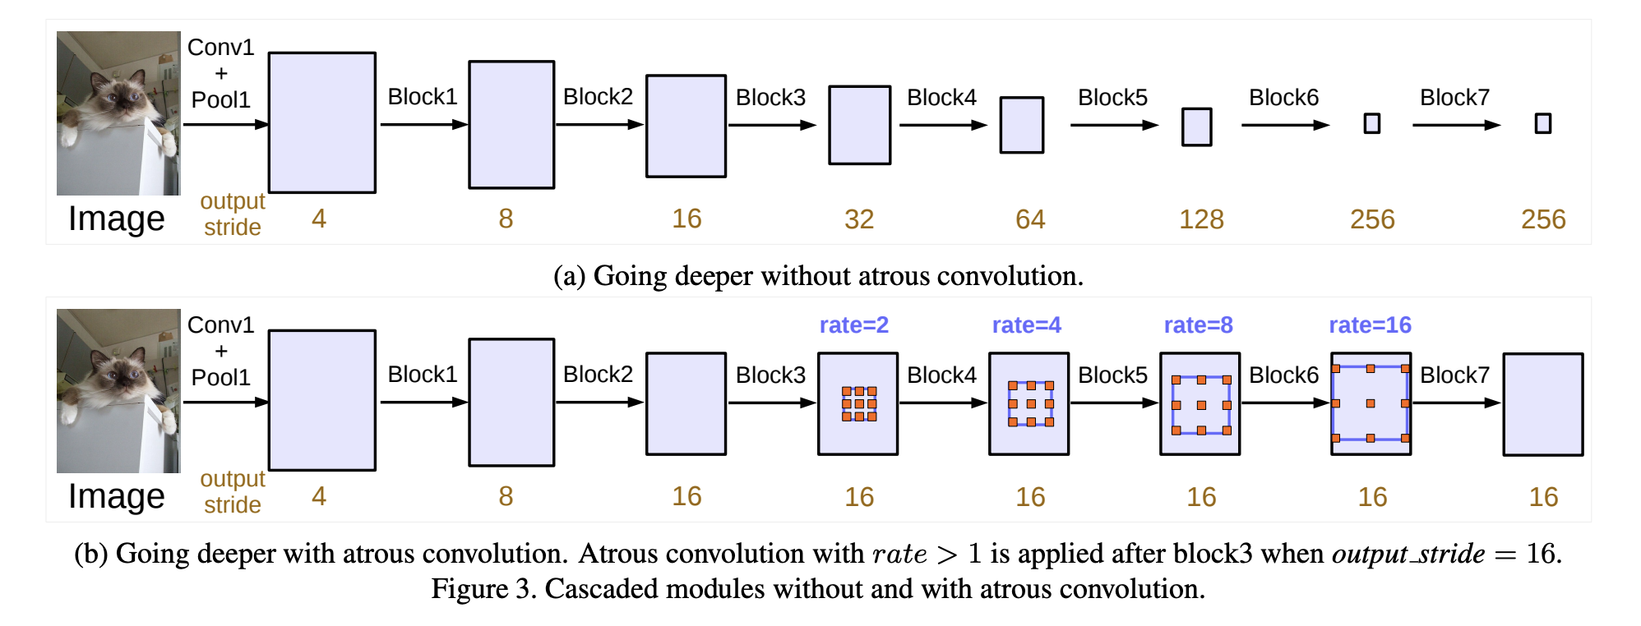
DeepLab V3 cont.
Atrous Spatial Pyramid Pooling (ASPP) is a semantic segmentation module for resampling a given feature layer at multiple rates prior to convolution.
This amounts to probing the original image with multiple filters that have complementary effective fields of view, thus capturing objects as well as useful image context at multiple scales.
Rather than actually resampling features, the mapping is implemented using multiple parallel atrous convolutional layers with different sampling rates.
We can say that DeepLab V3 is a better version of the ASPP

Slide 27
SCMM
A Spatially Constrained Mixture Model (SCMM) is a statistical model used in image processing for image segmentation, which involves dividing an image into multiple regions or segments.
SCMM is a type of mixture model that takes into account the spatial relationships between neighboring pixels in an image. It assumes that each pixel in an image belongs to a particular segment, and that the segments are drawn from a mixture of probability distributions.
In SCMM, the mixture model is constrained by a spatial prior, which encodes the spatial relationships between neighboring pixels.
This prior helps to enforce spatial continuity in the resulting segments, so that neighboring pixels that are similar are more likely to belong to the same segment.
The SCMM model is typically estimated using maximum likelihood or Bayesian inference methods, where the goal is to find the parameters of the mixture model that best fit the observed image data while respecting the spatial prior.
Once the model is estimated, it can be used for tasks such as object recognition, image annotation, or image retrieval.

Slide 28
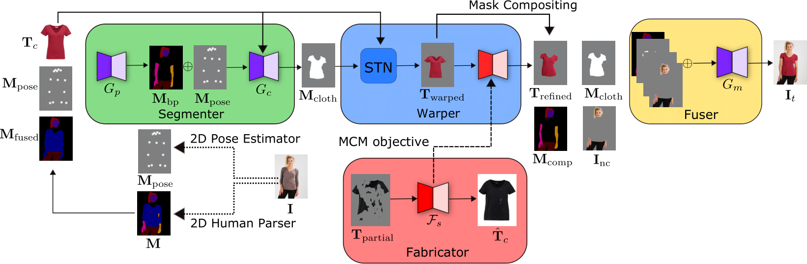
Architecture Diagram

Slide 29
Datasets Used
CP-VTON
Dress Code Dataset
HD-VTON

Slide 30

How does this happen:
You choose the type of clothing (t-shirt, pants, sweater, etc.)
Upload a photo of a person
You choose a specific clothing model
Get a generated photo of this person in the selected clothing

Slide 31
Partial Demonstration

Slide 32
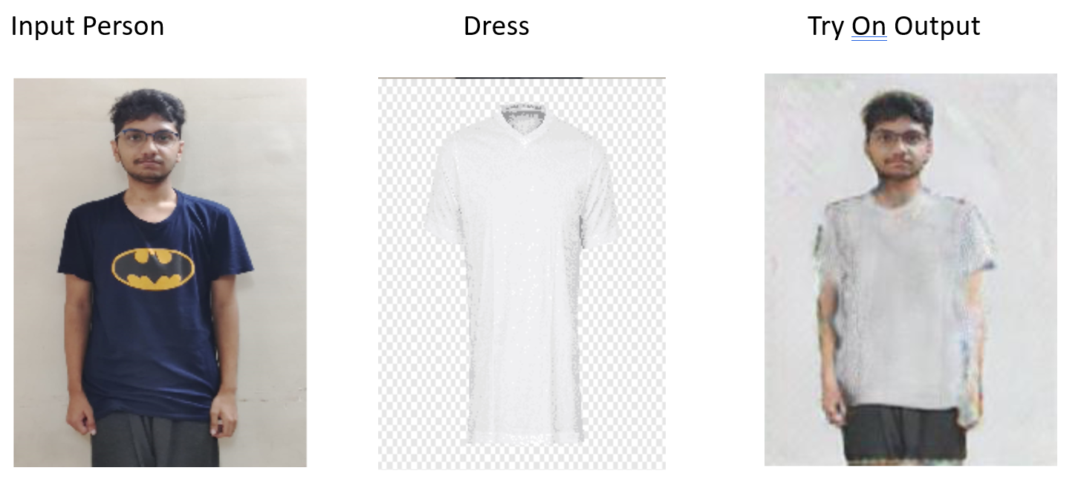

Slide 33
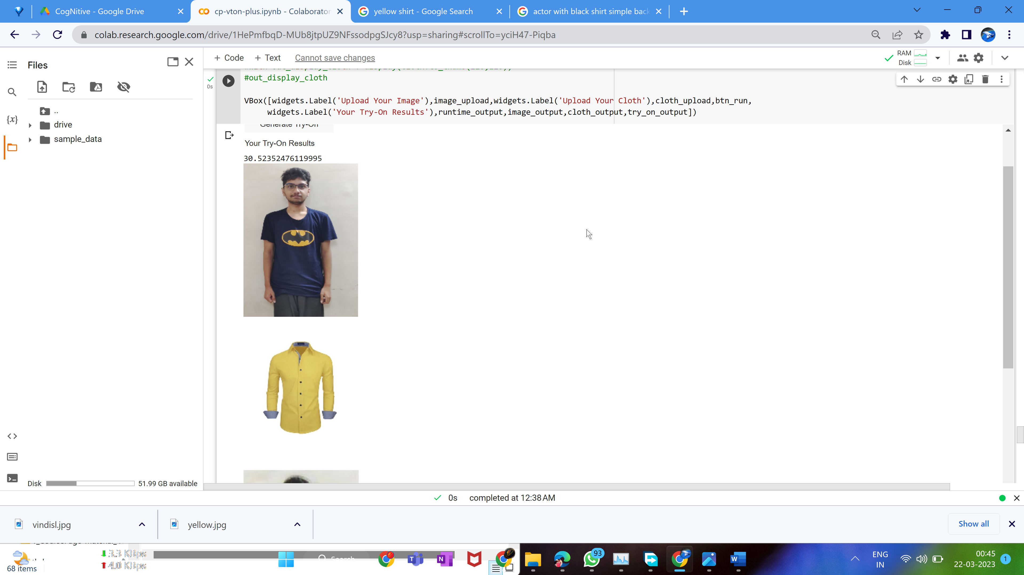
Partial Demonstration

Slide 34
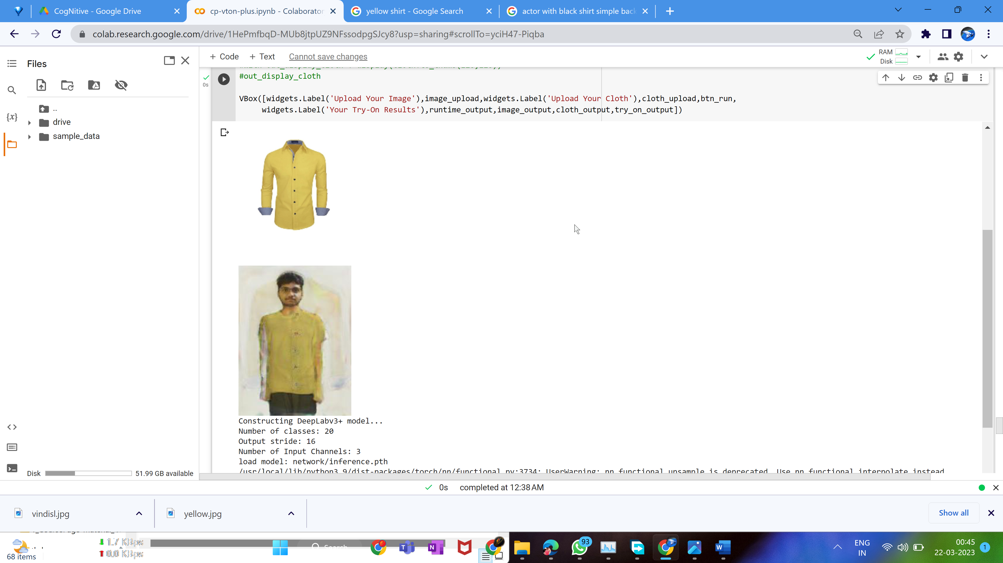

Slide 35
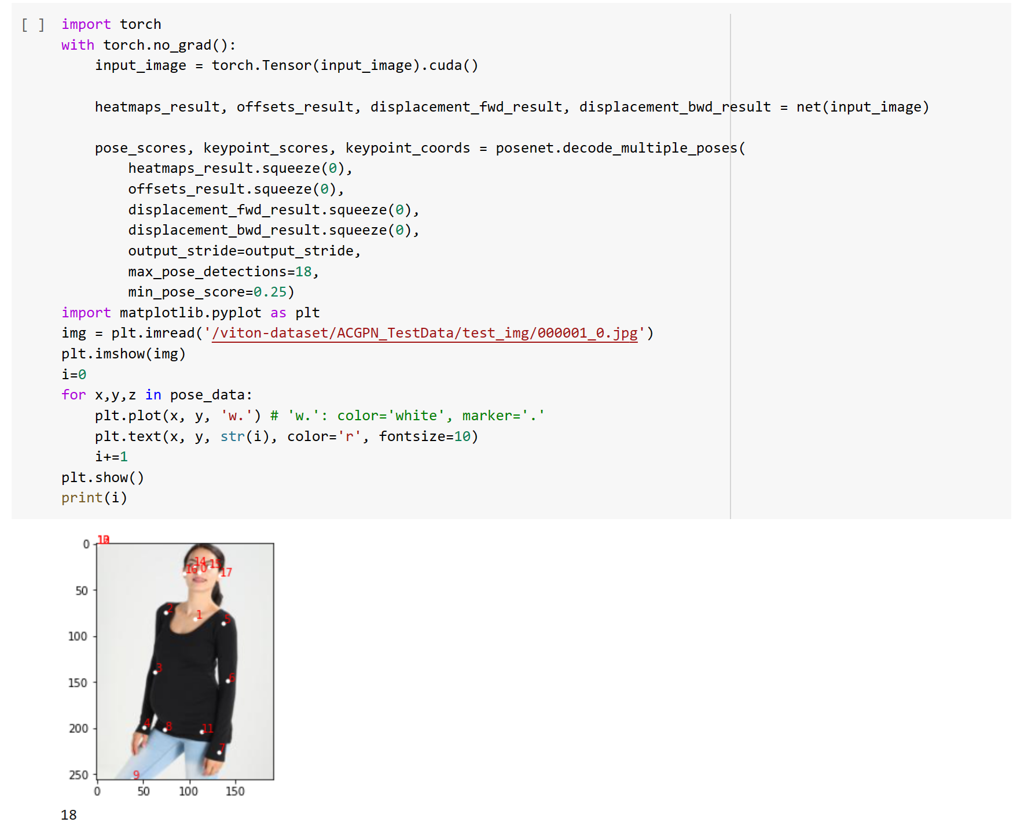
Future Modules to be completed
PSPNET
Increasing the number of fixed point to detect the cloth boundary.
In this review, it was 18, in final review, we will modify the max pose detection, score to make in 20+
More Layers

Slide 36
Conclusion
In the super-powered digital era, consumption has recently increased due to the use of artificial intelligence. The growing use of AI in the fashion industry raises fresh concerns about the standard of design and its societal ramifications. The basic value that alludes to Humanity and Art might be lost in design, which is a very humanistic undertaking. The broad use of digitization has created countless technological options and accelerated retail's ability to bring products to market, which is terrible for sustainability in the fashion industry. We hope that through our project we will be able to give a new insight or ways to the public to be able to select the fashion they want to consume. This will be useful for both heavy shoppers and also the casual ones.

Slide 37
Future Work
A Cognitive computer or system learn at scale, reasons with purpose and interacts with humans naturally. Rather than being explicitly programmed, these systems learn and reason from their interactions with human beings and their experiences with their environment.
So, in our Final Review, we’ll planning to add NLP, to get the human’s/users input after the Try on Result, and again try to run the model to get the desired result. Or else, Using the Explicit Cognitive Characteristic, when the user is not satisfied with the result to give an expected output.

Slide 38
References

Slide 39
[1]. Josyula, R., & Ostadabbas, S. (2020). A Review on Human Pose Estimation. Available at arXiv: https://arxiv.org/abs/2011.13828
[2]. Rana, S., Arora, A., & Hwang, D. (2022). Virtual try-on system for online apparel shopping: A review of recent advances and challenges. 2022 IEEE Conference on Virtual Reality and 3D User Interfaces Abstracts and Workshops (VRW), 514-516. doi: 10.1109/VRW55335.2022.00059
[3]. Ramanathan, V., Balakrishnan, G., & Balasubramanian, V. (2022). Enhancing the Virtual Try-On Experience with Personalized Recommendations and Virtual Stylists. 2022 IEEE/CVF Winter Conference on Applications of Computer Vision (WACV), 2226-2235. doi: 10.1109/WACV51458.2022.00226
[4]. Tripathy, A., Adhikari, B., & Naik, N. (2021). Virtual Try-On for Apparel: A Review and Analysis of State-of-the-Art Techniques. Available at SSRN: https://dx.doi.org/10.2139/ssrn.4157643
[5]. Wen-Huang Cheng, Sijie Song, Chieh-Yun Chen, Shintami Chusnul Hidayati, and Jiaying Liu. 2021. Fashion Meets Computer Vision: A Survey. ACM Comput. Surv. 54, 4, Article 72 (May 2022), 41 pages. https://doi.org/10.1145/3447239
[6]. Zheng, ZH., Zhang, HT., Zhang, FL. et al. Image-based clothes changing system. Journal of Electronic Commerce Research, Comp. Visual Media 3, 337–347 (2018). https://doi.org/10.1007/s41095-017-0084-6
[7]. Ghodhbani, H., Neji, M., Qahtani, A.M. et al. Dress-up: deep neural framework for image-based human appearance transfer. Multimed Tools Appl (2022). https://doi.org/10.1007/s11042-022-14127-w
[8]. Ge, Y., Zhang, F., Liu, Y., & Qian, X. (2019). DeepFashion2: A Versatile Benchmark for Detection, Pose Estimation, Segmentation and Re-Identification of Clothing Images. doi: https://doi.org/10.48550/arXiv.1901.07973
[9]. Liangchen Song, Gang Yu, Junsong Yuan, and Zicheng Liu. Human pose estimation and its application to action recognition: A survey. Journal of Visual Communication and Image Representation, Volume 76, 021,103055, ISSN 1047-3203, https://doi.org/10.1016/j.jvcir.2021.103055.
[10]. Lu, S.; Lu, F.; Shou, X.; Zhu, S. DeepProfile: Accurate Under-the-Clothes Body Profile Estimation. Appl. Sci. 2022, 12, 2220. https://doi.org/10.3390/app12042220

Slide 40
Thank You

